Slide 1

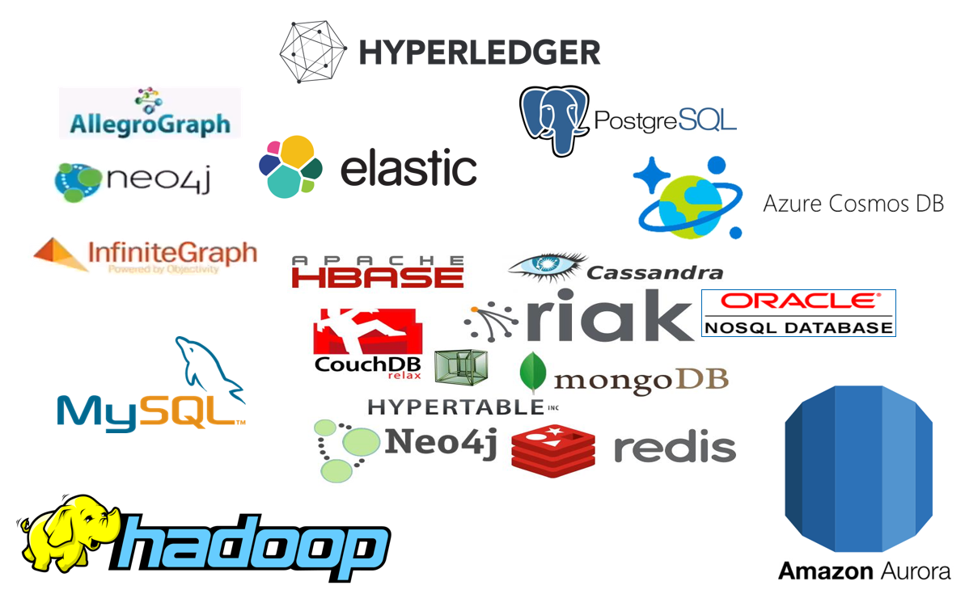





50 Shades of Data how, when and why Big, Fast, Relational, NoSQL, Elastic, Event, CQRS
On the many types of data, data stores and data usages
µ
µ
Lucas Jellema, CTO of AMIS
JEEConf, May 2018, Kyiv, Ukraine
Notes:
Fast data arrives in real time and potentially high volume. Rapid processing, filtering and aggregation is required to ensure timely reaction and actual information in user interfaces. Doing so is a challenge, make this happen in a scalable and reliable fashion is even more interesting. This session introduces Apache Kafka as the scalable event bus that takes care of the events as they flow in and Kafka Streams and KSQL for the streaming analytics. Both Java and Node applications are demonstrated that interact with Kafka and leverage Server Sent Events and WebSocket channels to update the Web UI in real time. User activity performed by the audience in the Web UI is processed by the Kafka powered back end and results in live updates on all clients.
Fast data arrives in real time and potentially high volume. Rapid processing, filtering and aggregation is required to ensure timely reaction and actual information in user interfaces. Doing so is a challenge, make this happen in a scalable and reliable fashion is even more interesting. This session introduces Apache Kafka as the scalable event bus that takes care of the events as they flow in and Kafka Streams for the streaming analytics. Both Java and Node applications are demonstrated that interact with Kafka and leverage Server Sent Events and WebSocket channels to update the Web UI in real time. User activity performed by the audience in the Web UI is processed by the Kafka powered back end and results in live updates on all clients. Introducing the challenge: fast data, scalable and decoupled event handling, streaming analytics Introduction of Kafka demo of Producing to and consuming from Kafka in Java and Nodejs clients Intro Kafka Stream API for streaming analytics Demo streaming analytics from java client Intro of web ui: HTML 5, WebSocket channel and SSE listener Demo of Push from server to Web UI - in general End to end flow: - IFTTT picks up Tweets and pushed them to an API that hands them to Kafka Topic. - The Java application Consumes these events, performs Streaming Analytics (grouped by hashtag and author and time window) and counts them; the aggregation results are produced to Kafka - The NodeJS application consumes these aggregation results and pushes them to Web UI - The WebUI displays the selected Tweets along with the aggregation results - in the Web UI, users can LIKE and RATE the tweets; each like or rating is sent to the server and produced to Kafka; these events are processed too through Stream Analytics and result in updated Like counts and Average Rating results; these are then pushed to all clients; this means that the audience can Tweet, see the tweet appear in the web ui on their own device, rate & like and see the ratings and like count update in real time

Slide 2
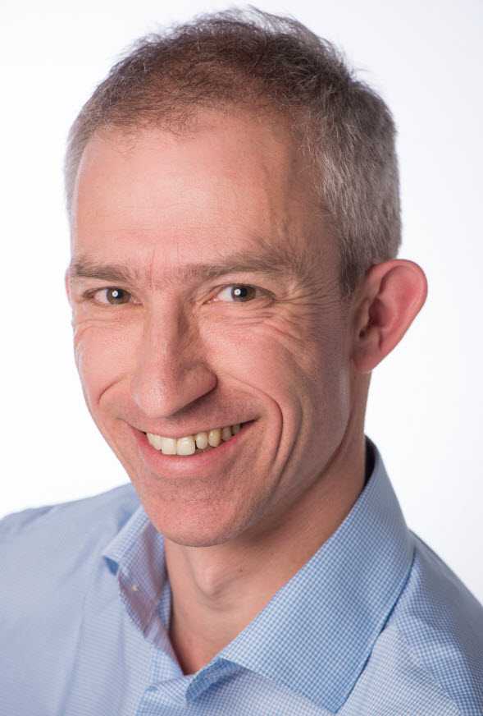
Lucas Jellema Architect / Developer 1994 started in IT at Oracle 2002 joined AMIS Currently CTO & Solution Architect

Slide 3

Presenting
Oracle OpenWorld
JavaOne
Oracle Code
Devoxx
Java and Oracle User Group meetups
Java Rockstar (JavaOne 2015)
JEEConf

Slide 4

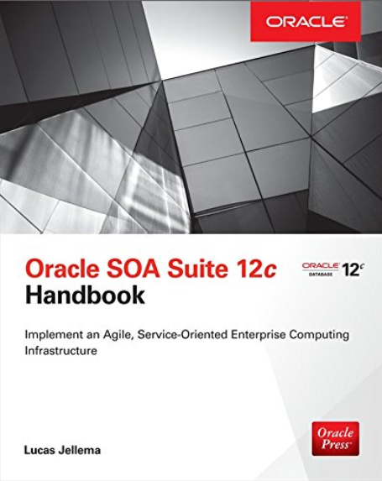


Writing
Blogs at http://technology.amis.nl
1500 articles – from UI to Middle Tier, Database and Infrastructure
Articles at Medium, DZone and Oracle Technology Network
Books for McGraw Hill (Oracle Press)
Oracle ACE Director & Developer Champion

Slide 5

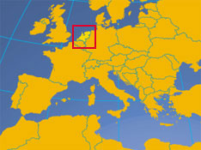
From The Netherlands

Slide 6
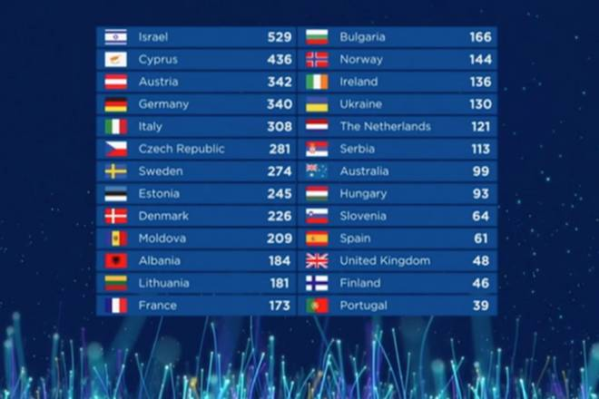

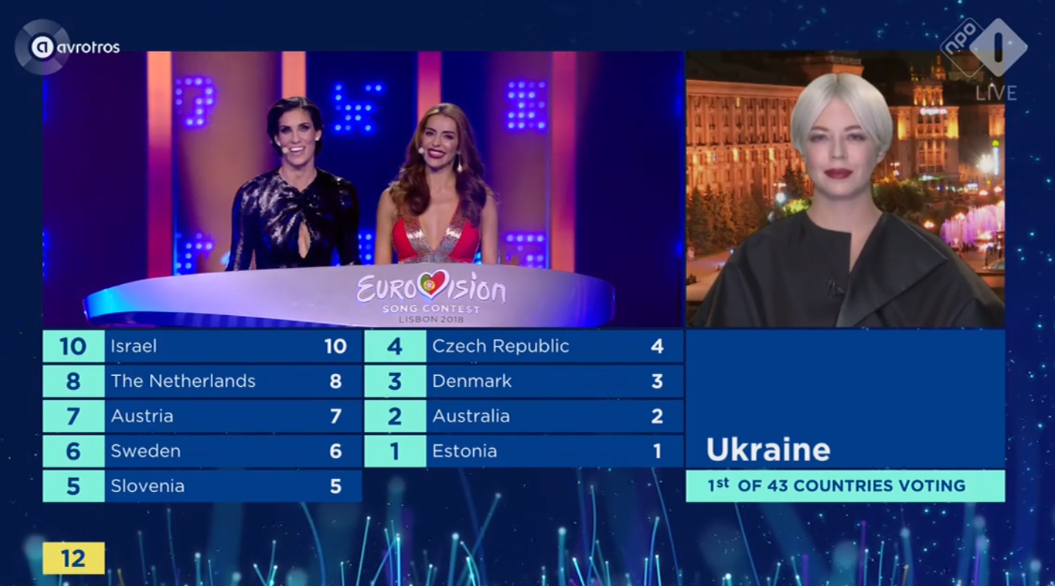
From The Netherlands

Slide 7


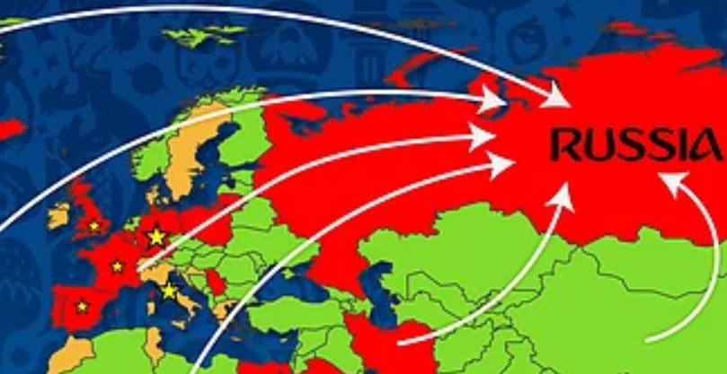


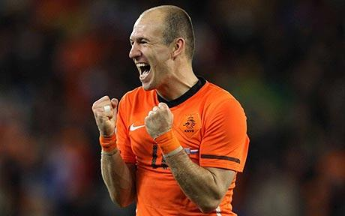

Slide 8
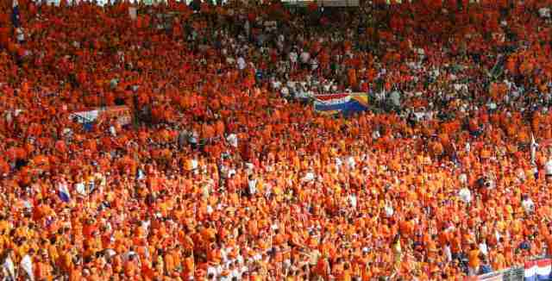



History with the color orange

Slide 9

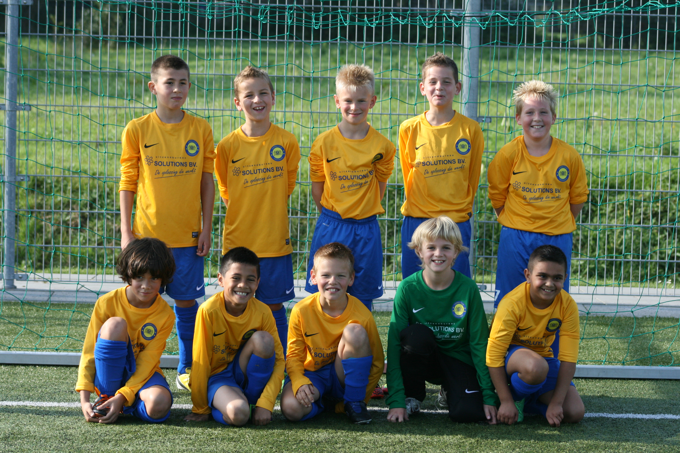



My hometown of Zoetermeer

Slide 10
I Need Your Help. Tweet! #JEEConf

Slide 11
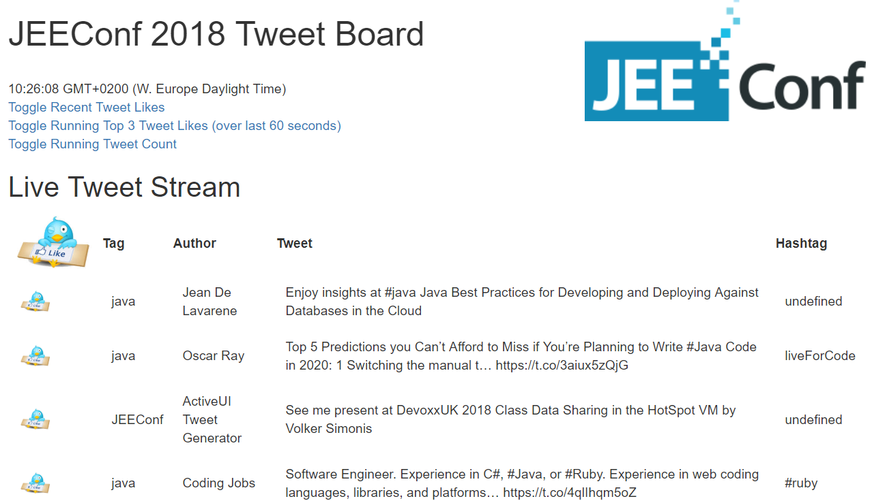
Tweet Monitor – Fast Streaming Data Analysis
Demo
UI- tweets streaming in
KSQL Command line
Select from tweets where tagFilter=“JEEConf”
Select count(*) from tweets
UI Tweet Count

Slide 12
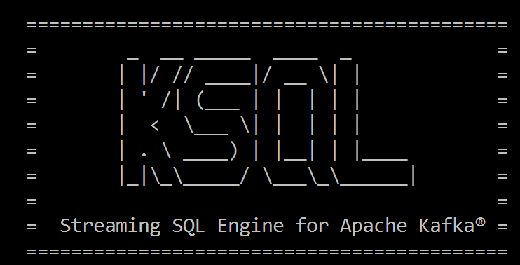
Select from <stream of tweet events>
select text , author , timestamp
from tweets
Where tag = 'JEEConf'

Slide 13
Select Running Count from <stream of tweet events>
select tag
, count(*) tweet_count from tweets
group by tag

Slide 14
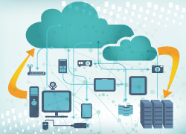
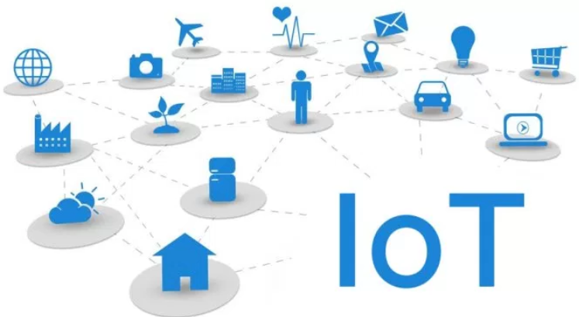

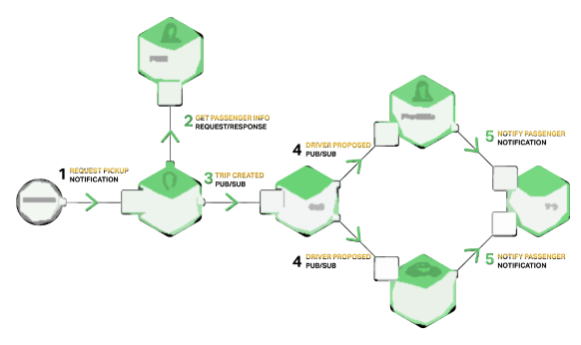













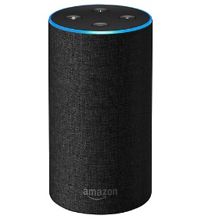
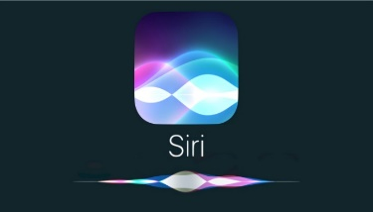

Oracle Cloud
Tweets on #JEEConf #java #oraclecode
IoT metrics from hundreds of devices
User actions & click events from webshop
Live Traffic Events
Microservices chatter
Social Media events (Facebook, Whatsapp, …)
IT Operations – monitoring metrics
Application Container
Event Hub
Tweets
Topic
Client
Client
Client
Client
Running Tweets Aggregation
SSE
µ
TWEET_COUNT Topic
µ
µ
µ

Slide 15

Real Time

Slide 16
Real Time live | fresh | instantaneous | on line | synchronous

Slide 17


Slide 18


Slide 19


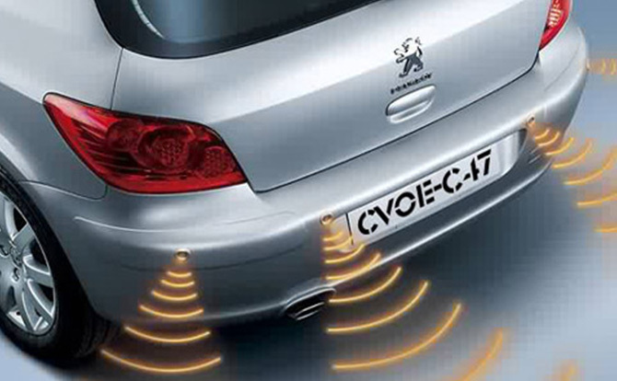

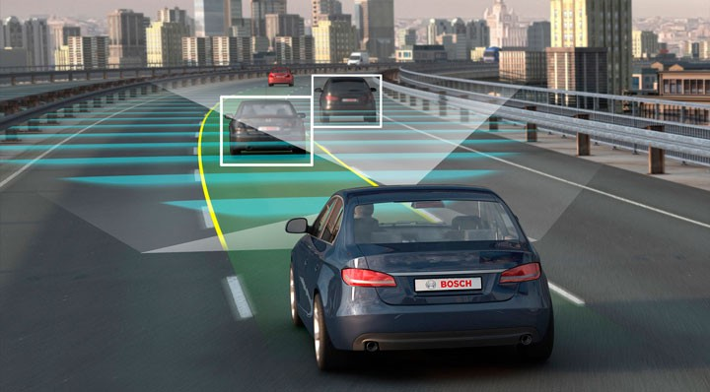
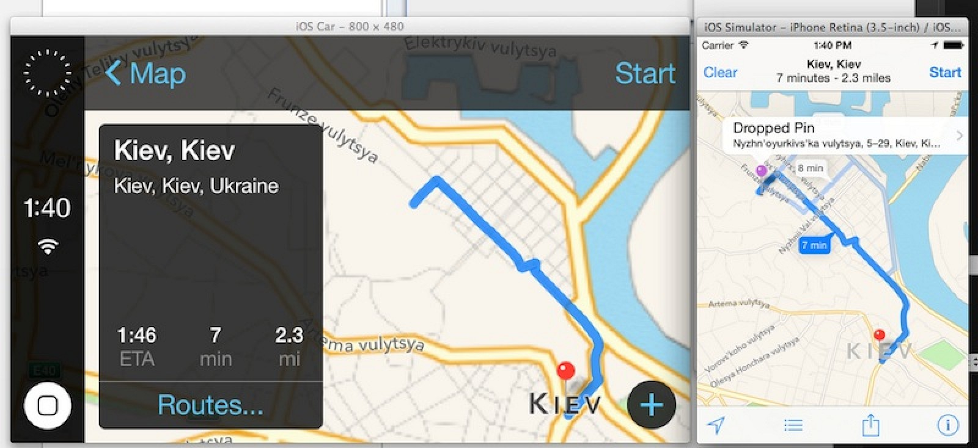
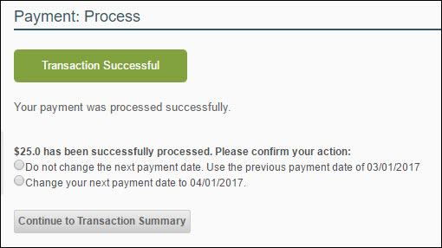
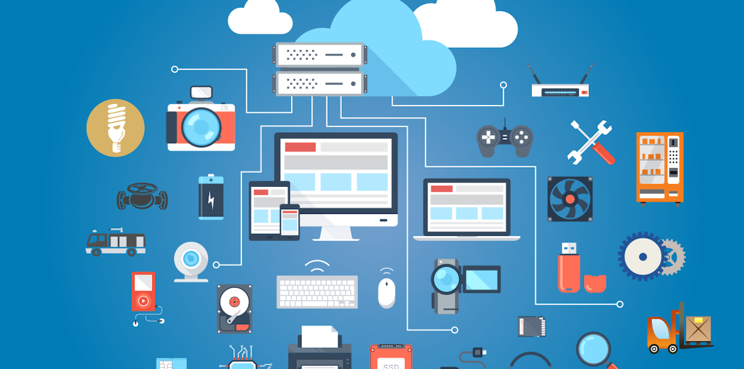

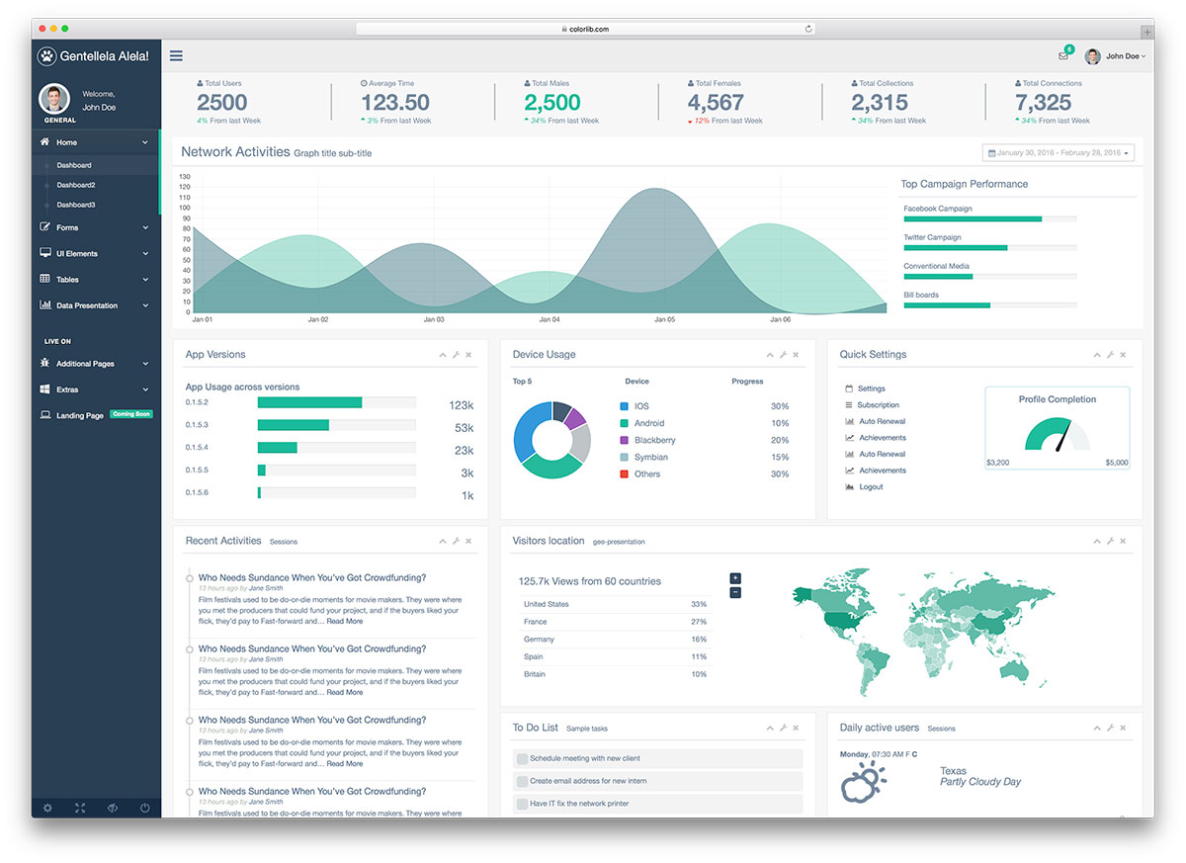

Slide 20


Slide 21

< 10 ms
< 100 ms
< 500 ms
<3 secs
> 3 secs
Machine Response
Human Reaction
21

Slide 22

< 10 ms
< 100 ms
< 500 ms
<3 secs
> 3 secs
Machine Response
Human Reaction
22

Slide 23

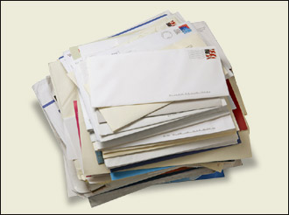

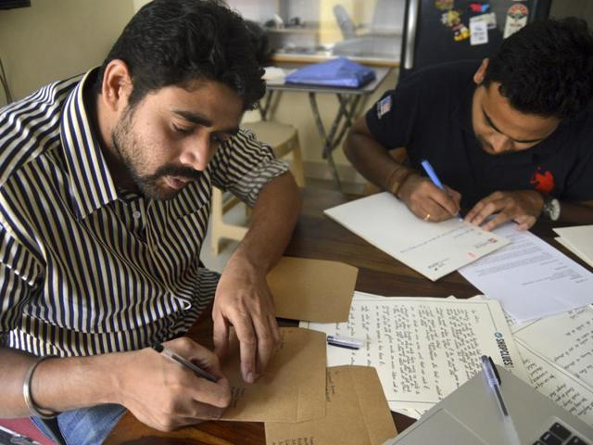
Quest for fresh data
2 min
36 hr
10 min
BPM Engine
Processing cases for Customers
2%
1 min
48 hr
Background Batch Process
(preparing letters for customers)
Customers
2 wk

Slide 24

Doctor & Patient

Slide 25



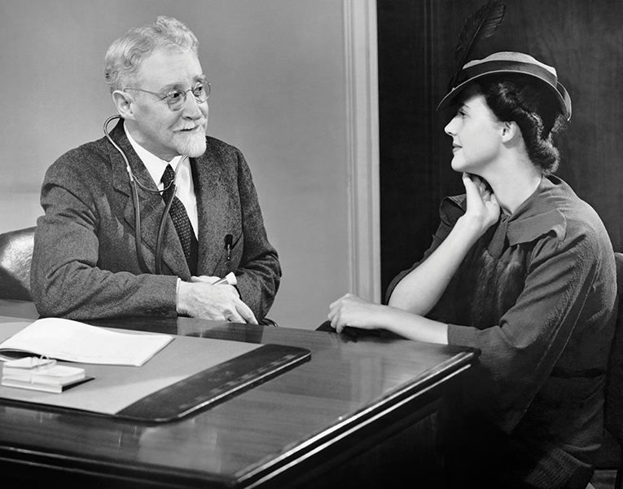



Slide 26
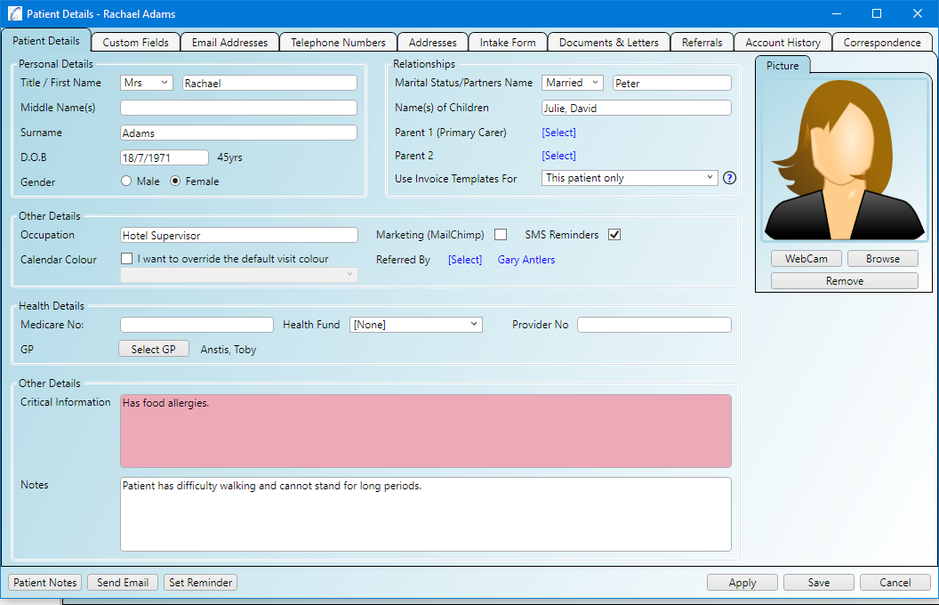
Operational Data Store
API
On demand, synchronous
Batch, background, asynchronous

Slide 27
+ Available
+ Performant
+ Preprocessing of data
- Authorization enforcement
- Cost of ODS (platform)
+ Fresh data
+ No duplication of data
- Complexity
Operational Data Store
API

Slide 28



Slide 29


Slide 30



Slide 31

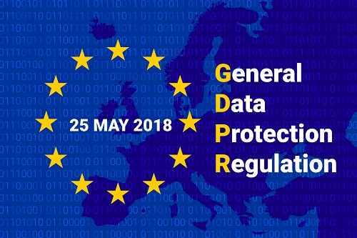

Slide 32
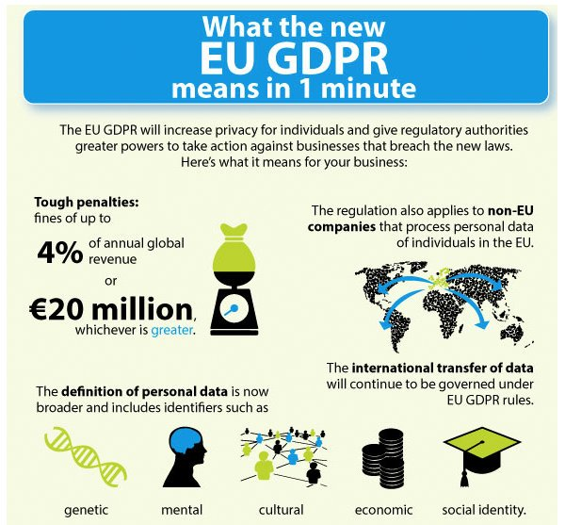

Slide 33









PI(I)

Slide 34

It’s you!
Notes:
PII = Personally Identifiable Data

Slide 35
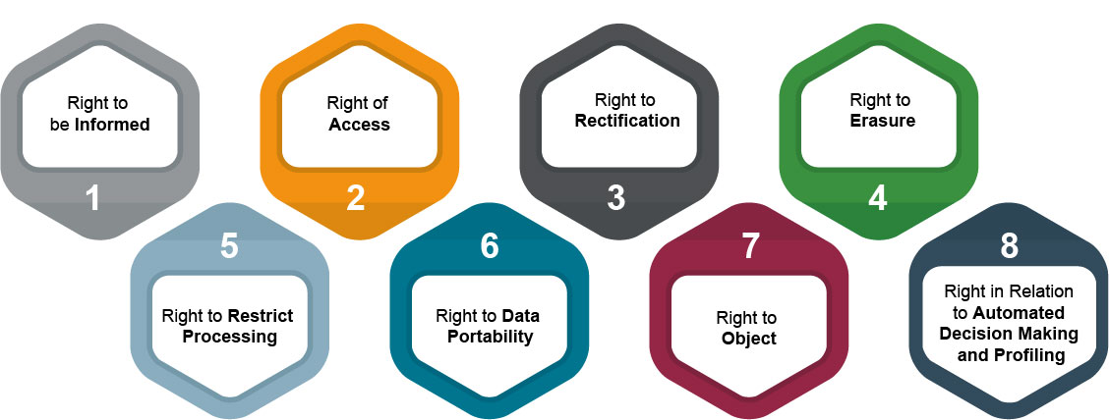
Data Subject’s Right under the GDPR

Slide 36


Operational Data Store
API

Slide 37

Integrity
Madelon’s pasje
Real world vs World of Databases
Relax!
Anomaly detection

Slide 38

Data Constraints to protect integrity
Allowable values
Mandatory attributes
(Foreign Key) References
NULL
Constraints on
type
length
format
Spelling
Character encoding
Notes:
https://specify.io/concepts/microservices

Slide 39


Data is representation of the known real world
How useful is it to enforce data integrity?
Notes:
https://specify.io/concepts/microservices

Slide 40

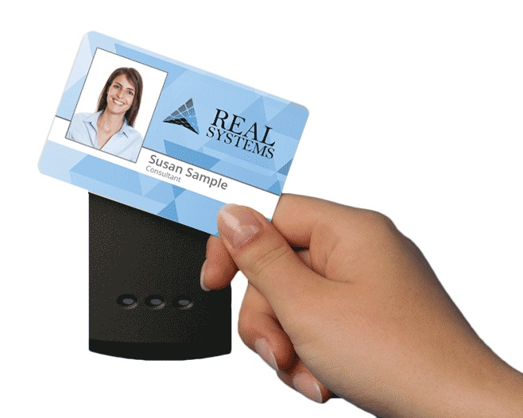



Virtual Reality
Notes:
https://specify.io/concepts/microservices

Slide 41

Data Integrity
Why?
Is it about truth?
About regulations and by-the-book?
Allow IT systems to run smoothly and not get confused?
About auditability and non-repudiation?
What about the real world?
Data in IT is just a representation; if the world is not by the book – what should IT do?
Notes:
https://specify.io/concepts/microservices

Slide 42
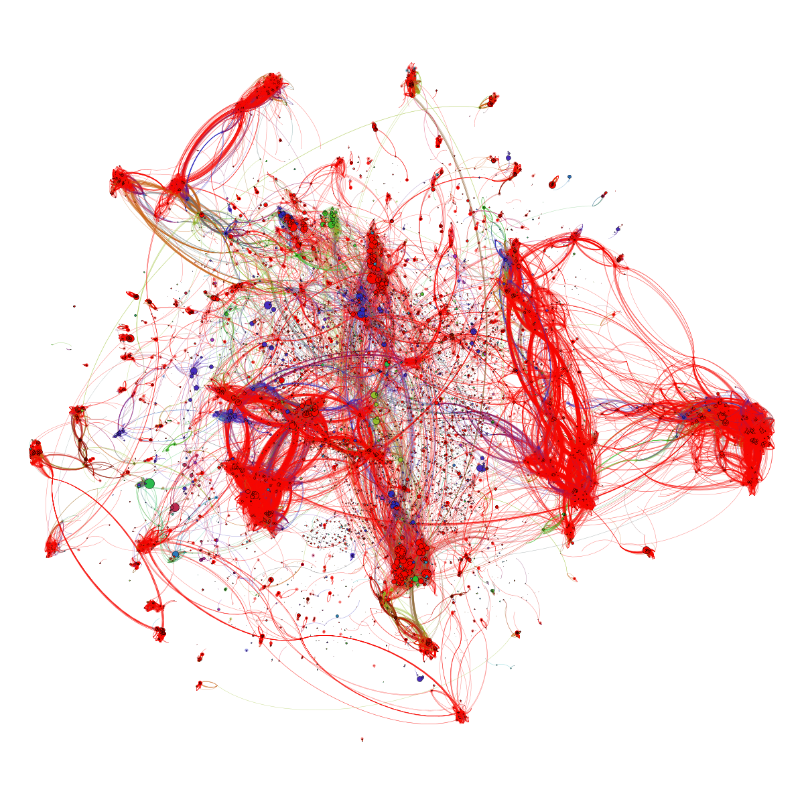

Slide 43
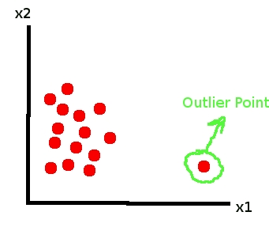
Anomaly Detection
Find fishy values and derive business integrity rules by scanning data

Slide 44

BOL - CQRS

Slide 45

Books Online - WebShop
Products
Webshop visits
searches
product details
Orders
Product updates
Read only
On line
Speed is crucial
XHTML & JSON
> 5M visits
Data manipulation
Data Quality (enforcement)
<10K transactions
Batch jobs next to online
Speed is nice
firewall

Slide 46


Nightly generation
DMZ
Webshop visits
searches
product details
Orders
Products
Products
Products
Products
Product updates
Read only
On line
Speed is crucial
XHTML & JSON
> 1M visits
Read only
JSON documents
Images
Text Search
Scale Horizontally
Stale but consistent
Data manipulation
Data Quality (enforcement)
<10K transactions
Batch jobs next to online
Speed is nice
firewall

Slide 47
Products
Data Manipulation
Data Retrieval

Slide 48
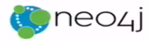



Products
Data Manipulation
Quick Product Search Index
Special Products
Data Retrieval
Toys
Product Clusters
Product Store in SaaS app
Food Stuff
Notes:
Data manipulation and retrieval in separate places
(physical data proliferation)
Query store is optimized for consumers
Level of detail, format, filters applied
For performance and scalability, independence, productivity lower license fees and lower TCO, security

Slide 49
Comand Query Responsbility Segregation = CQRS
Detect changes
Products
Extract Data
Data Manipulation
Transport Data
Convert Data
Special Products
Apply Data
Data Retrieval
Toys
Quick Product Search Index
Product Clusters
Food Stuff
Product Store in SaaS app
Notes:
No Event Sourcing
No events (?)
No green field
Packages Applications/SaaS
Databases (RDBMS, NoSQL) getting changes from applications directly
Challenges – at scale, with enough speed and consistently: do not let query store get into an exposed state that could not exist/be right!
Detect relevant changes
Extract relevant changes
Transport
Convert
Apply in correct order and reliably (no lost events)
Note: after detect and extract, an event can be published

Slide 50


From C to Q
How quickly?
How frequently?
How reliably?
How atomically?
What about consistency?
Products
Quick Product Search Index

Slide 51


Slide 52
From C to Q
How quickly?
How frequently?
How reliably?
How atomic?
When consistent?
Data Authorization Considerations
Locations & Connectivity
Full resynch | restore of Query Store
Products
Quick Product Search Index

Slide 53

[let go of] The Holy Grail of Normalization
Normalize to prevent
data redundancy
discrepancies (split brain)
storage waste

Slide 54
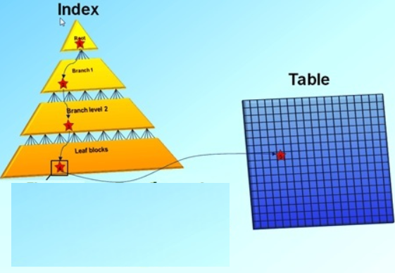
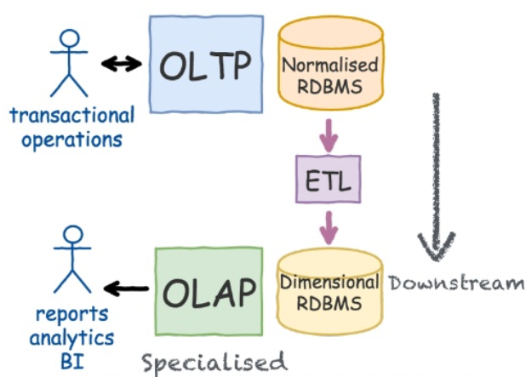
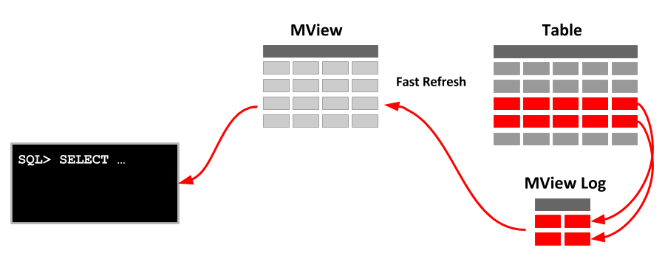
CQRS is not new
Notes:
https://www.slideshare.net/LorenzoNicora/from-c-to-q-one-event-at-the-time-event-sourcing-illustrated

Slide 55
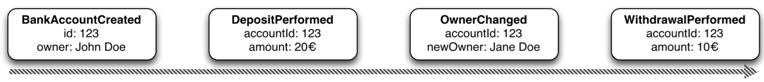
Event Sourcing Driving CQRS
amount: 10
Owner: Jane Doe
Events
Current State
Event Store
accountId: 123
Notes:
Events are immutable facts
Current state (active record) is derived from sum of events
Read optimized aggregates are created for specific use case – based on events and rebuildable at any time

Slide 56
Event Sourcing Driving CQRS
Events
Current State
Event Store
Other State Aggregate
Notes:
Events are immutable facts
Current state (active record) is derived from sum of events
Read optimized aggregates are created for specific use case – based on events and rebuildable at any time

Slide 57
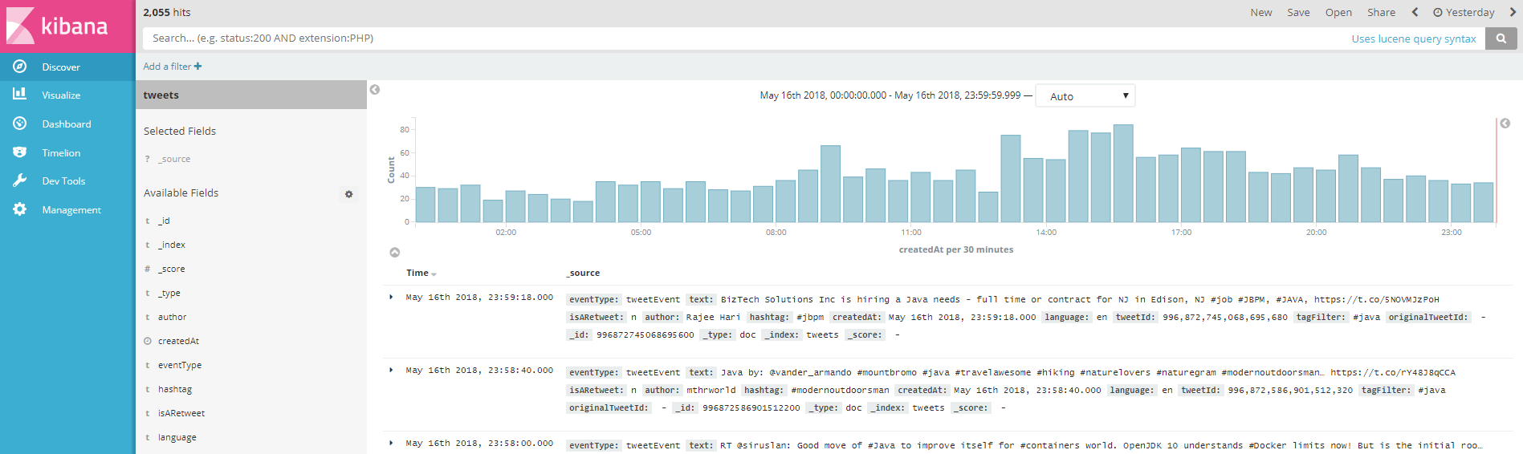

Oracle Cloud
Application Container
Event Hub
Tweets
Topic
Application Container
Container

Slide 58

SQL is not good at anything
But it sucks at nothing
Notes:
https://specify.io/concepts/microservices

Slide 59
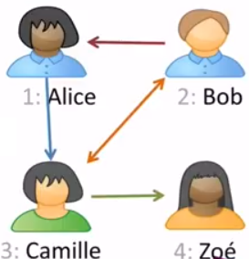
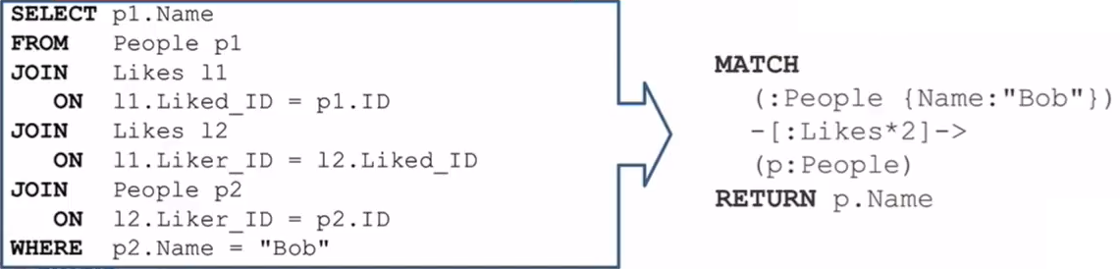
Graph Database
Natural fit during development
Superior (10-1000 times better) performance
Find People liked by anyone liked by Bob
Person liked by anyone liked by Bob
Find People liked by anyone liked by Bob
Notes:
https://specify.io/concepts/microservices

Slide 60
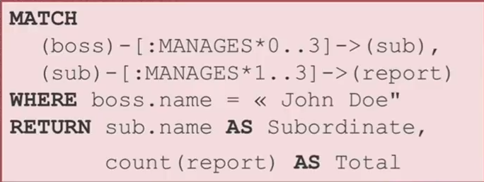
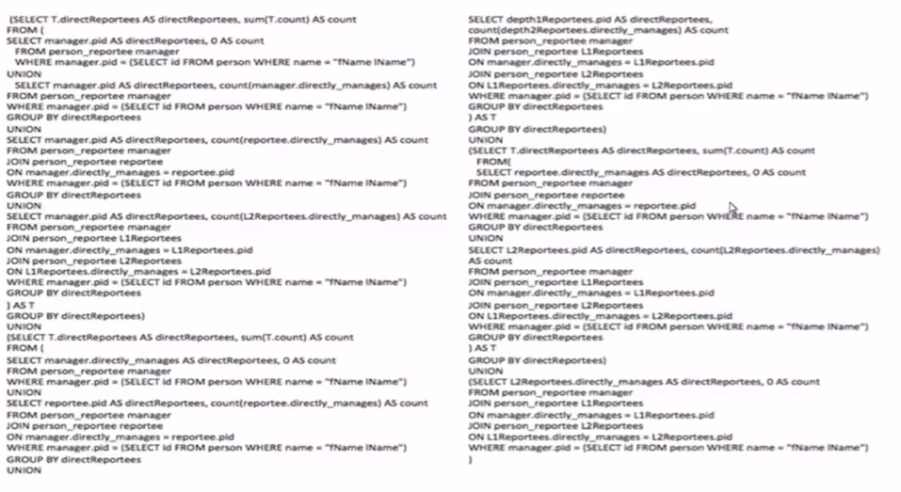
From relational SQL to Graph query
Notes:
https://specify.io/concepts/microservices

Slide 61
SQL vs NoSQL

Slide 62
SQL vs NoSQL ACID vs BASE Relational vs …

Slide 63
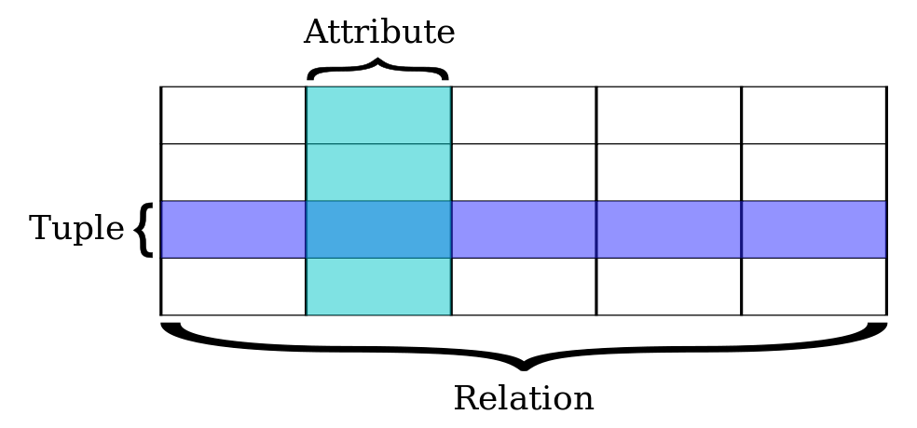
Relational Databases
Based on relational model of data (E.F. Codd), a mathematical foundation
Uses SQL for query, DML and DDL
Transactions are ACID (Atomicity, Consistency, Isolation, Durability)
All or nothing
Constraint Compliant
Individual experience [in a multi-session environment] (aka concurrency)
Down does not hurt
Notes:
https://specify.io/concepts/microservices

Slide 64
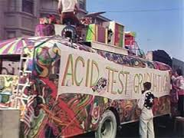
ACID comes at a cost – performance & scalability
Transaction results have to be persisted [before the transaction completes] in order to guarantee D
Concurrency requires some degree of locking (and multi-versioning) in order to have I
Constraint compliance (unique key, foreign key) means all data hangs together (as do all transactions) in order to have C
Two-phase commit (across multiple participants) introduces complexity, dependencies and delays, yet required for A
Notes:
https://specify.io/concepts/microservices

Slide 65
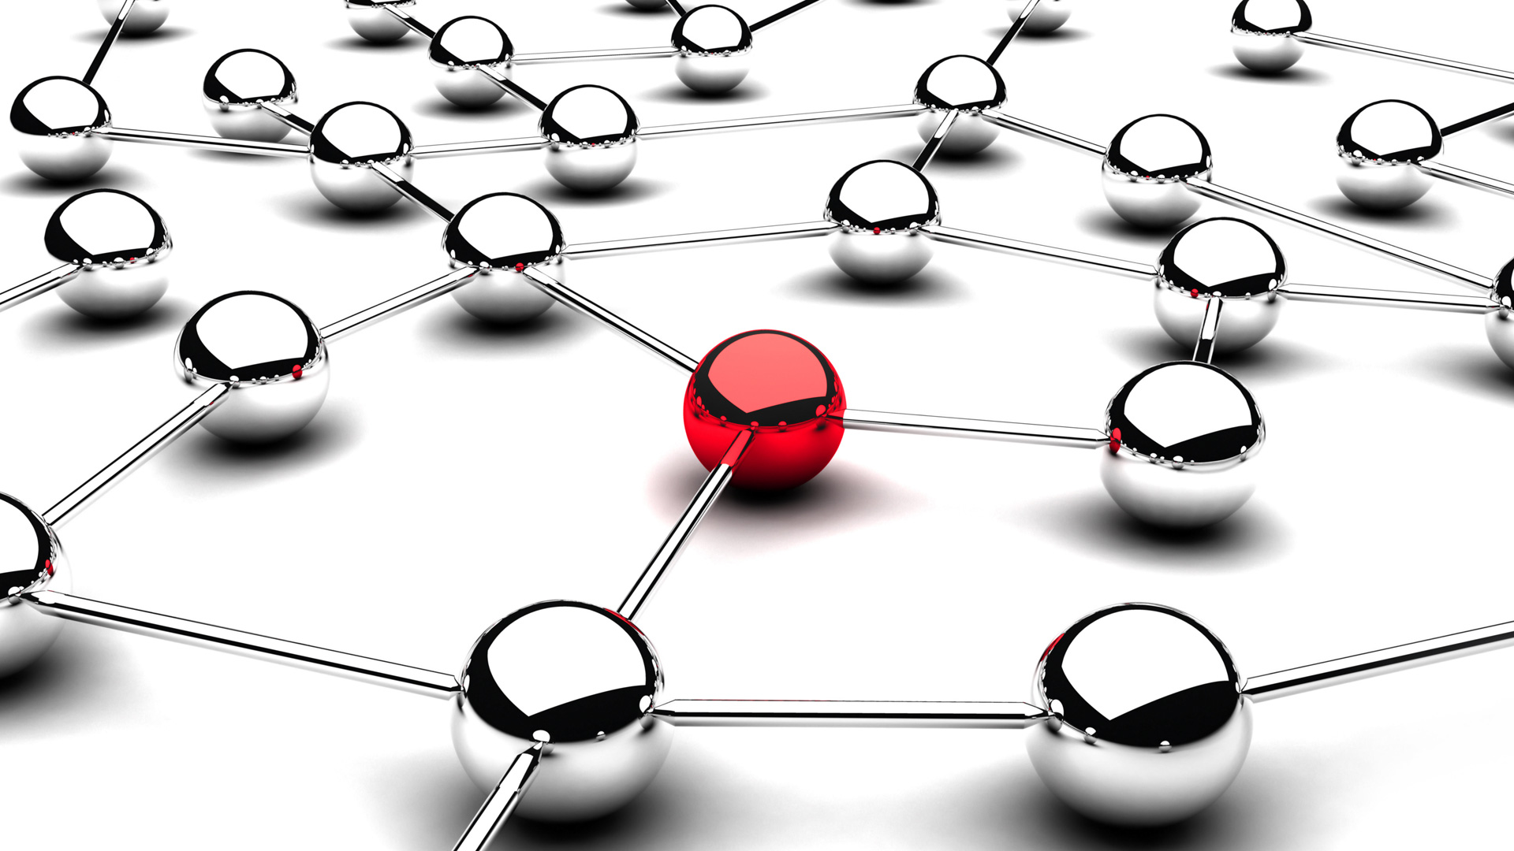
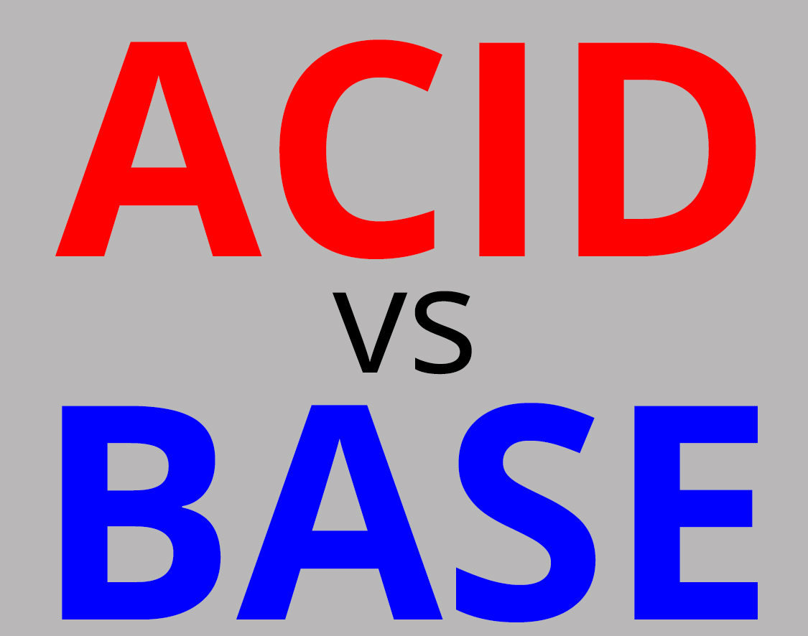



Notes:
WebScale
‘No ACID
BASE
Speed, reads
Redundancy
Read-optimized format
Not all use cases require ACID (or can afford it)
Read only (product catalog for web shops)
Inserts only and no (inter-record) constraints
Big Data collected and “dumped” in Data Lake (Hadoop) for subsequent processing
High performance demands
Not all data needs structured formats or structured querying and JOINs
Entire documents are stored and retrieved based on a single key
Sometimes – scalable availability and developer productivity is more important than Consistency – and ACID is sacrificed
CAP-theorem states: Consistency [across nodes], Availability and Partition tolerance can not all three be satisfied

Slide 66


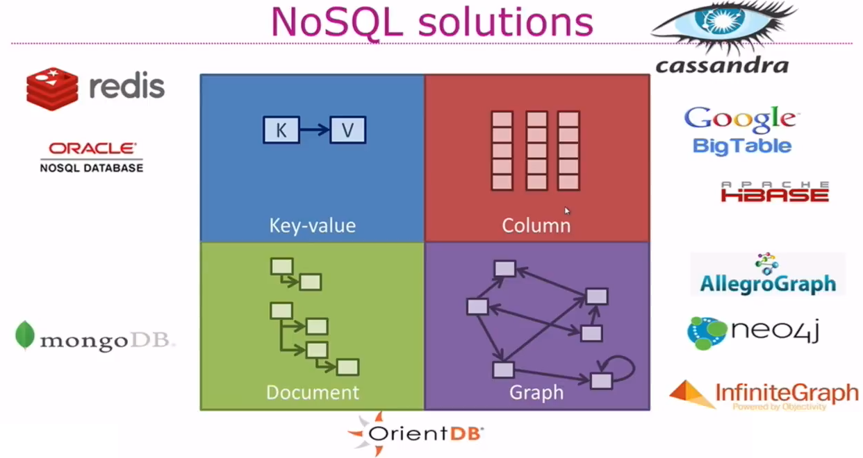


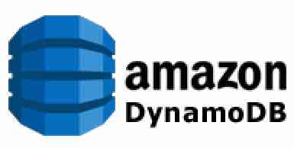




Types of NoSQL
Notes:
https://specify.io/concepts/microservices

Slide 67
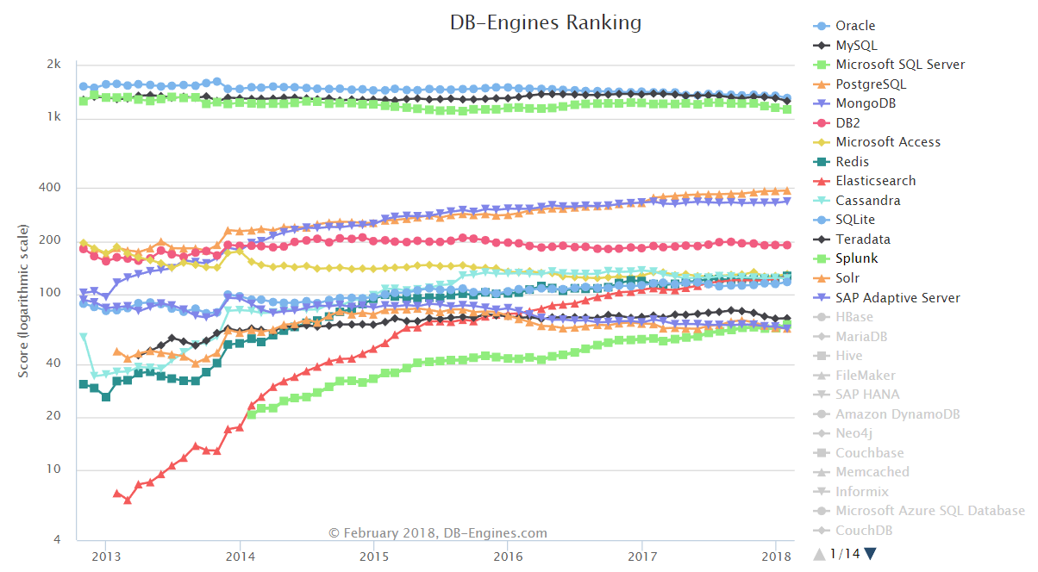

(leading) NoSQL Database products
MongoDB is (one of) the most popular (by any measure)
Elastic Search and Cassandra are close contenders
Cloud (only):
Google BigTable,
AWS Dynamo
Cache (in memory)
ZooKeeper, Redis, Coherence, Memcached, Apache Ignite (pka GridGain), …
Hadoop/HDFS
Oracle NoSQL (fka Berkeley DB)
Notes:
https://specify.io/concepts/microservices

Slide 68


Slide 69




NoSQL n’est pas No SQL

Slide 70


Slide 71
When things were simple
RDBMS
SQL
ACID
SAN
Backup
Data files
Log Files
Backup
Backup

Slide 72

And then stuff happened
Mobile App (offline)
Client Tier: Browser
Mobile App (offline)
Client Tier: Browser
Mobile App (offline)
API
Client Tier: Browser
API
API
µ
λ
Middle Tier:
Java EE (Stateful) application
Fast Data
OO, XML, JSON
Data Warehouse
Content Management
Big Data

Slide 73













Slide 74
Oracle Database
SQL
RDBMS
ACID

Slide 75














http
http
IoT Fast Data Ingestion
Flashback
Machine Learning
Big Data SQL
Sharding
No SQL
Multitenant (Pluggable Database) Architecture

Slide 76



Slide 77




Slide 78



Slide 79



Slide 80
http
http
IoT Fast Data Ingestion
Flashback
Machine Learning
Big Data SQL
Sharding
No SQL
Multitenant (Pluggable Database) Architecture

Slide 81



Slide 82



Oracle Database XE – eXpress Edition
Current version: XE 11gR2
Coming in August 2018: XE 18c, with yearly releases (19c, 20c, …)
All functionality of single instance Oracle Database Enterprise Edition plus Extra Options
(including R, Machine Learning, Spatial, Compression, Multi Tenant, Partitioning)
Code and Data Compatible with other editions – including plug/unplug
Resource Limitations for 18c:
2 CPUs
2 GB of memory
12 GB of disk space (using Compression effectively 40 GB of data)
No patches or support

Slide 83
http
http
IoT Fast Data Ingestion
Event Sourcing
Machine Learning
Big Data SQL
Sharding
No SQL
Multitenant (Pluggable Database) Architecture

Slide 84

Time Machine

Slide 85


Query all versions | past states | change events of a record

Slide 86

Turn Transaction History into Events
http
Products

Slide 87



Event Sourcing from Database Transaction Log
Product Modified Event
DBaaS
Pro ducts
History
http
DML
Products
Topic
generate
events
Notes:
Reconstruct DML Events
Reconstruct History
Reverse Engineering of Event Source
DEMO Flashback Query & Flasback Versions Query
Publish Events from Database using HTTP (or Stored Java)
QCRN, Trigger + Job, Log Mining, Scheduled Flashback Job,

Slide 88

Final Demo
Microservices
Microservice

Slide 89


Slide 90

Microservices
Agile | Flexible | Scalable | (Re)Deployable
Independent | Decoupled | Isolated
Communicate asynchronously, via events
Have their own private bounded context – the data they require to function
Their lifeblood

Slide 91
Microservices State
Generic Platform for running microservices
LDAP
Big Data
Block Storage
Cache
RDBMS
NoSQL
Document Store
Event Hub
Notes:
All data stores are distributed
Or at least distributedly available
They can be local or on cloud (latency is important)
Data in generic data store is still owned by only one microservice – no one can touch it
Only in DWH and BigData do we deliberately take copies of data and disown them

Slide 92
Bounded context in microservices
A micoservice needs to be able to run independently
It needs to contain & own all data required to run
It cannot depend on other microservices
UI
API
Customer
API
Order
CustomerModified event

Slide 93


Demo – Maintaining Derived Data in Bounded Context
Customer Microservice
Order Microservice
Customer Modified Event
Application Container
Application Container
Event Hub
Customers
Topic
DBaaS

Slide 94
Wrap Up

Slide 95


Slide 96












Notes:
Data used to be like T-Ford
One model, one color
And then:

Slide 97

location
Total Cost of Data Ownership
query patterns
usage
volume
volatility
format
distribution
required consistency
freshness requirements (staleness allowance)
integrity
speed
authorization
ACID demands
ownership
availability
Notes:
Data comes in many shades (at least 50) – variations along many dimensions

Slide 98





Slide 99






Slide 100

Notes:
technologies

Slide 101
Wrap Up
DATA
DATA
DATA
DATA
DATA
DATA
DATA
DATA

Slide 102





Дякую Спасибо Thank you Dank je wel
Blog: technology.amis.nl
Email: lucas.jellema@amis.nl
: @lucasjellema
: lucas-jellema
: www.amis.nl, info@amis.nl
https://github.com/lucasjellema/50-shades-of-data-jeeconf2018-kyiv
Notes:
Ukranian: Dyakuyu - https://www.google.nl/search?q=thank+you+in+ukrainian&rlz=1C1GGRV_enNL762NL762&oq=thank+y&aqs=chrome.1.69i59l2j69i61j0j69i57j0.1774j0j9&sourceid=chrome&ie=UTF-8
Russian: Spasibo

